Slide 1

Civil Plan Designed for ABC Housing Ltd.
Name: Protik acharjay
ID: 20-42715-1
Section: I
Course: Computer Aided Design and Drafting
Spring 20-21

Slide 2
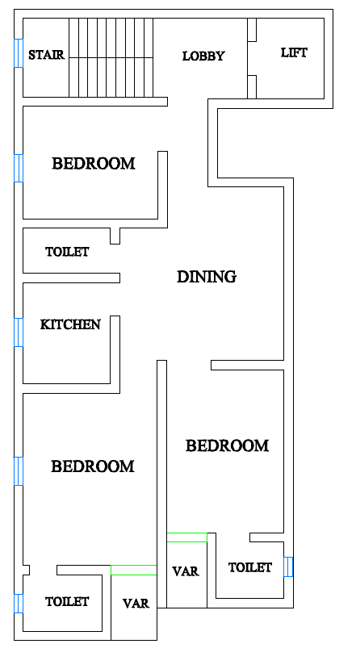

Slide 3
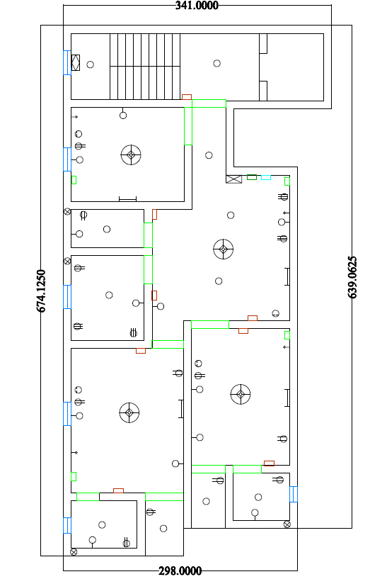
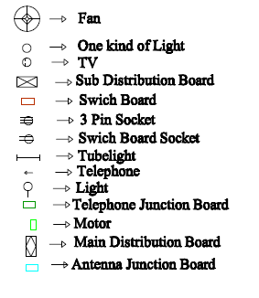

Slide 4
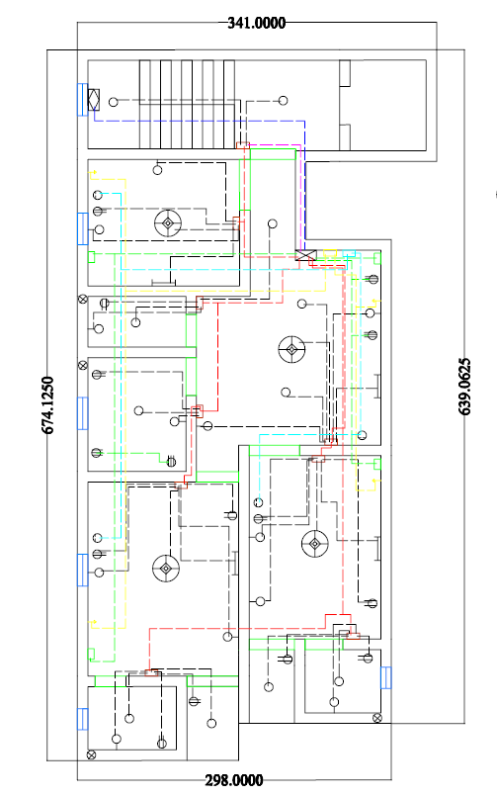
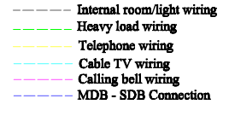

Slide 5


